Slide 1








Working in the Community Sector
(as a young person)
Notes:
follow up from last years discussion on crisis
- low pay
- how to retain young people
- older

Slide 2





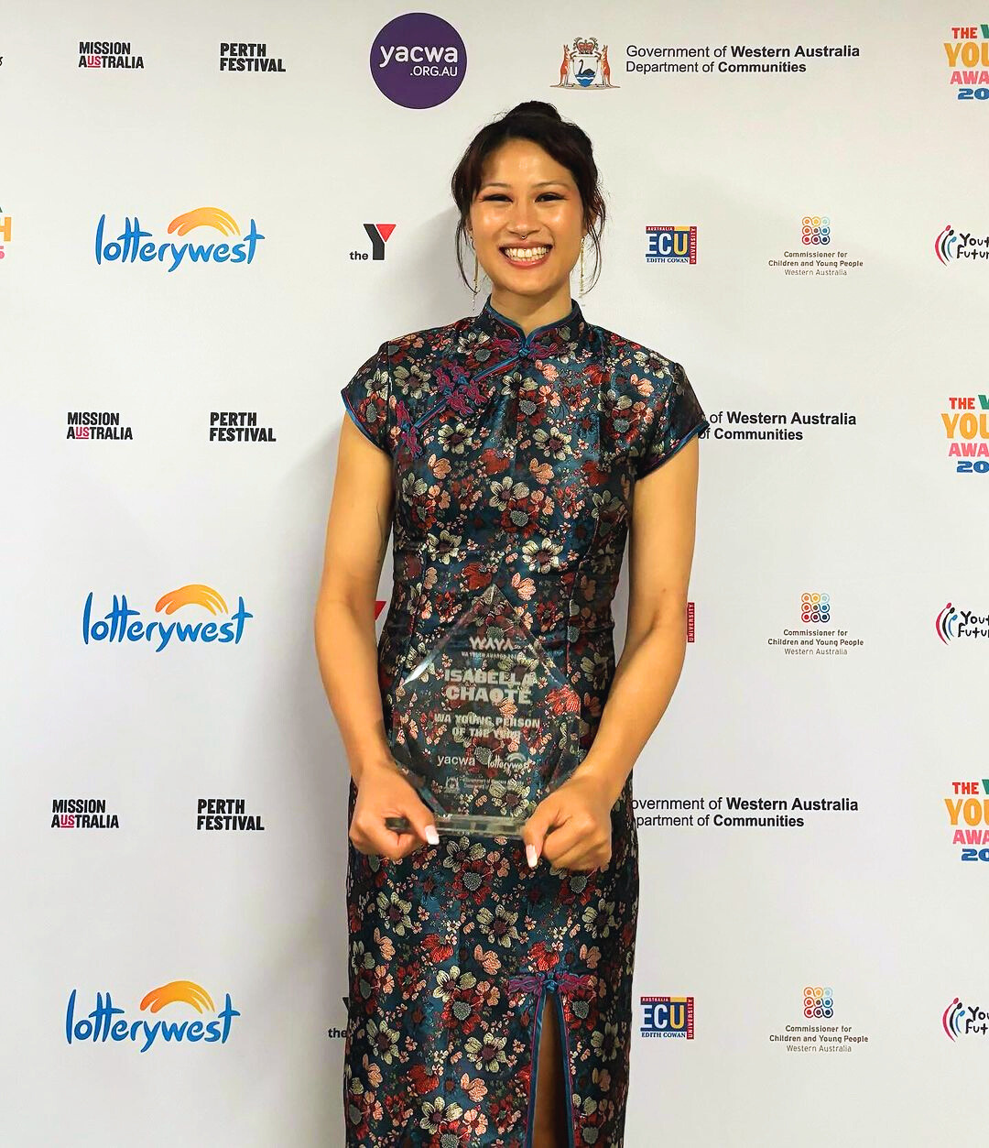




Introduction
Isabella (they/them)
Experience as both:
  a young professional
  a position of management
  Interim CEO - Youth Disability Advocacy Network
  Young Person of the Year 2023
  Disability Pride Festival 2024
Lived Experience Advocate
Notes:
part of the role of YDAN is

Slide 3
Lets answer the questions:
1) How do we be more inclusive of young people in the sector?
2) How do we attract more young people to the sector?
Notes:
we know there is a workforce crisis
we know young people are struggling to pay bills
we know there is a cost of living crisis

Slide 4
What we know:
  There is a workforce shortage
  The community sector is ageing
= we need more young people!

Slide 5
How do we solve this?

Slide 6
How do we solve this?
What are young people’s experiences?

Slide 7


When did you figure out what your current job role is?
Notes:
ask you to reflect
- keeping this in mind, think about when you were a young person

Slide 8


You are a young person
Notes:
now lets think of you as a young person. lets say you have no work experience (or at least not professional setting/relevant).
lets add lived experience of disability - mental ill - health
- taken years off of your professional experience due to prioritising your health
- may experience higher rates of discrimination/not be able to get a job
- you don't have expectations of your workplace because you've never worked elsewhere

Slide 9




What are the social expectations? What are the pre-existing relationships in this space?
How should I dress for this meeting?
Another ACRONYM?!
I don’t know what that word means? I better google it quickly
Why have I been asked to do this? It makes no sense to the project...
Brain of a
Young Person
@ Work
Why was I turned down for that opportunity?
I don’t know what I’m doing but no one has said anything so...
Is my manager allowed to do that?
I want to start taking on more responsibility but I don’t know how?
Am I ever going to get that upskilling I was promised?
Notes:
I didn't know:
- diff. between part time and full time
- what an operations team was, what a board is
- how organisations function? where do you get your money from? what is a manager, director, ceo?
- how to read a payslip
- types of leave
- rules around taking breaks
no one ever taught me the basics. We are all just expected to know some things about the workplace ...

Slide 10

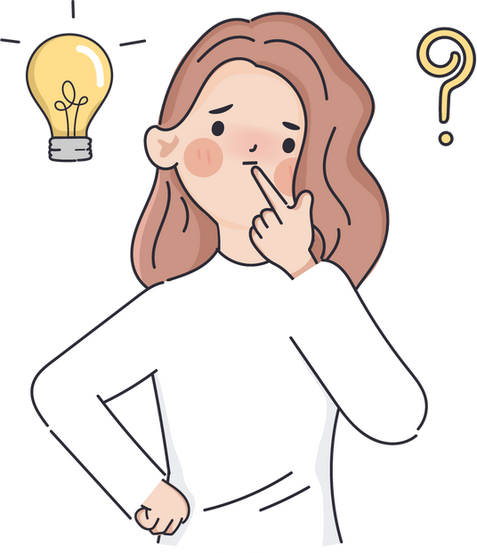
UNSURE ABOUT:
Reading payslips
Professional Standards
How an organisation works
Jargon
Workplace rights
Social Expectations
Notes:
let's draw out some of those themes. We have a young person who is unsure of all of these aspects of work
now individually these might not be a big deal but..

Slide 11
Paid incorrectly
Miss out on opportunities to progress
UNSURE ABOUT:
No big picture thinking
Reading payslips
Professional Standards
Not participate fully
How an organisation works
Jargon
Lack confidence
Exploitation
Workplace rights
Social Expectations
Notes:
now we have a young person who isn't going to progress because they don't know what progression looks like, they aren't confident in what they're doing, and up miserable and isolated, quit
- without developing professionally,
so much to think about, so much pressure (internally or externally) to get it right.

Slide 12

TURN UNSURE SURE
Workplace rights
Upskilling session
Using HR FAQ
Payslips
Video putting in timesheets
FAQ Leave types
How an org works
Advice for new staff
Discuss team roles
Transparency
Social expectations
Clear expectations
Social scripts
Judge/Tell
Jargon
Sector Glossary
Acronyms
Describe the sector
Notes:
How and org works/social expectations - tips and tricks - closing a meeting, how to respond when someone says ..
how does the organisation work? how do we get funding? how do you decide when...
include people in decision making processes
so we've set the scene on what its like being a young person in the sector, how we can creatively meet the needs of young people - some of the issues they face. Now lets think about how to attract young people to the workforce.

Slide 13


Young People’s Needs & Values
Financial Security
Flexibility
Sustainable work-life balance
Set expectations
Confidence in their team
Speak the silent parts out loud!!
Value aligning work
Understanding team leaders
Notes:
so what are young peoples work needs? what will keep them around.
Example from YDAN: PwD who work at different paces.
Talk of performance management
- set people up for success
- trust our people to do the work
- allow people to take the breaks they need without judgement
- respect that people are "going through it" all the time. disability such as mental health, chronic illness, ...

Slide 14

Gen Z workplace trends
1
Not tied to a job
2
Flexibility - working remotely
3
Commitment to their lives outside of work
4
Very values driven
5
Prefer to text over call
6
Mental wellbeing a priority

Slide 15
Ways we work at YDAN
1
Flexible start times (hard start times)
2
WFH/WFB matching capacity
Discuss the big picture/transparency
Cultural accessibility & attitudes towards accessibility
3
4
5
Trust + learning the language
6
Wins/Learning Opportunities & sharing what works
Notes:
Needs + values + general work attitudes =
physical access - discussions week to week about what we need
learning the language - grants, sector,

Slide 16
Answers to the questions:
1) How do we be more inclusive of young people in the sector?
2) How do we attract more young people to the sector?
Notes:
the same answer. if we cater to young people and challenge ableist and outdated ways of working, you will not only attract young people but retain them

Slide 17





Take aways
There is no “how to work” guidebook. Don’t assume young people know how a workplace operates.
There are many ways to support young people in the workplace. They can be creative and fun!
1
3
Ask the needs of your young people. Ask them their dream approach to work - how can you meet that?
Don’t underestimate the power of confident young people.
2
4

