Slide 2
Background

Slide 5
Purpose
Levels and forms of stakeholder engagement, from communication through to partnership
How partnerships are conceptualised and defined and the building blocks of effective collaboration
The different stages of developing and maintaining partnerships: from scoping and establishing, through to planning and designing, implementation, monitoring and evaluation
Examples of partnering in practice
Sample evaluation questions to help measure partnership effectiveness

Slide 6
To partner or not to partner?
Not all circumstances require a partnership and there is no standardised partnership model to adhere to

Slide 8
Planning for Partnership

Slide 9
Partnership Stages and Building Blocks
Partnership Stage 1
Scoping and Establishing
Relationships
Power
Vision, Mission and Purpose

Slide 10
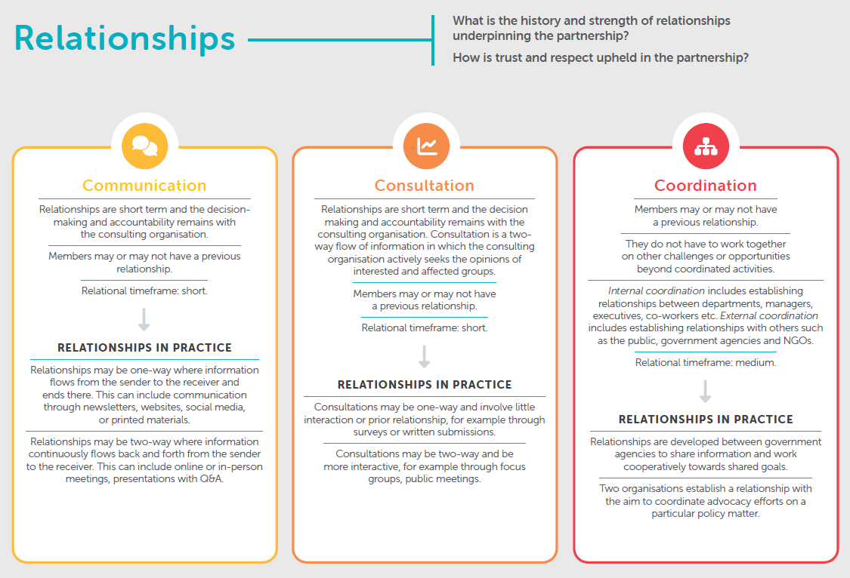

Slide 11
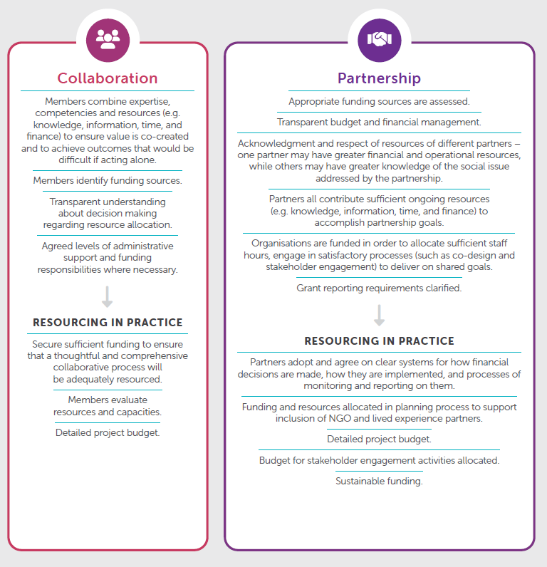

Slide 12
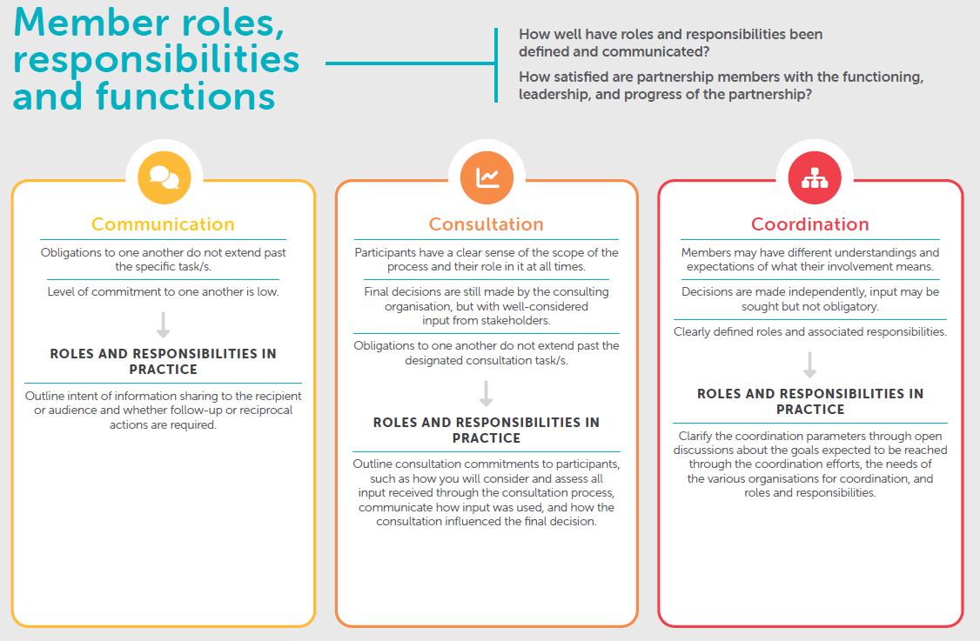
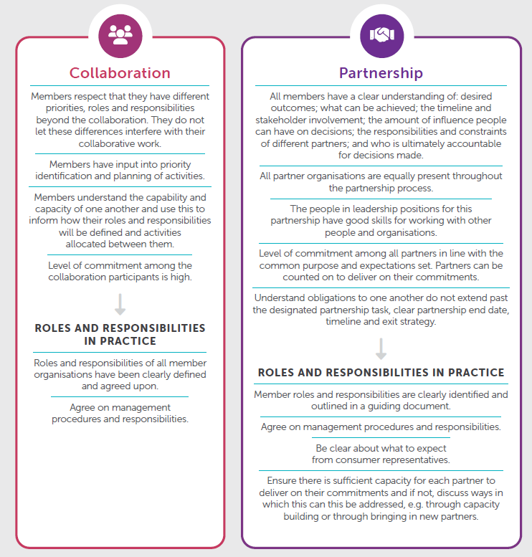

Slide 13
Partnership Building Blocks

Slide 14
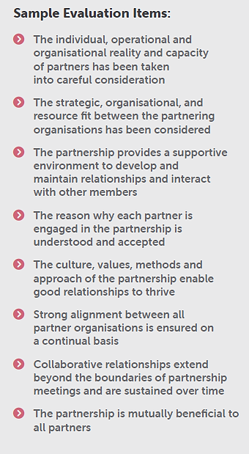

Slide 15
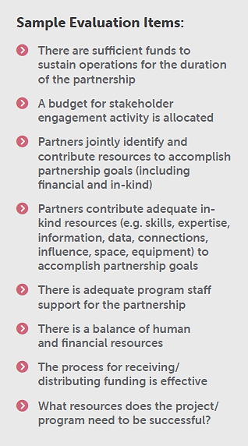

Slide 16
Building Partnering Capacity

