Slide 1
Business Continuity Planning
2 March 2022
Dawn Smith

Slide 2
Business Continuity Plan (BCP)
Scenario Planning
Information technology
COVID Risk in the Community
Staff Member on site with Symptoms
Staff member off site with Symptoms
Confirmed Case
Branch closure full or partial
Restoring service

Slide 3
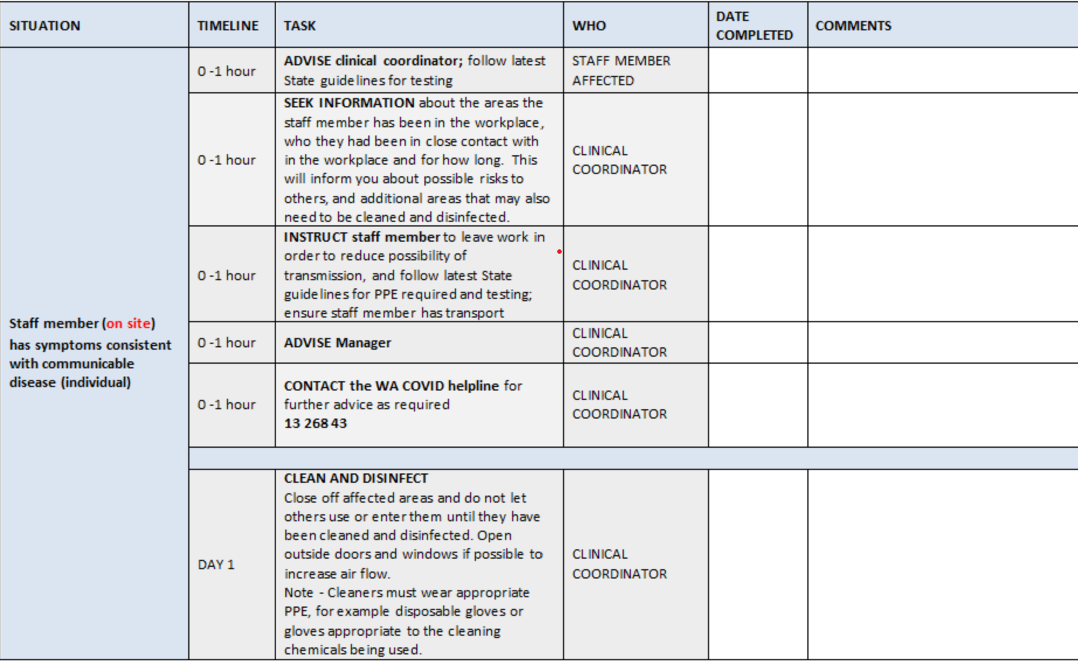
Title
Text
Text
Text

Slide 4
Weekly BCP Meeting
Discussion includes
Actions
Current Climate, including emerging issues
Review of BCP
Service actions
WFH
Split Teams
Remote working
Staff well being
Staffing
All organization communication follows the BCP

Slide 5
Regional staffing
Split Teams
Team A on site
Team B WFH
Workforce pool
Critical workers registration

Slide 6
Thank you

