Slide 1
COVID-19 Workforce Planning
Planning for the worst-case scenario and hoping for the best

Slide 2
Acknowledgement of Country
Ngala kaaditj Wadjuk Noongar moort keyen kaadak nidja boodja.
We, the staff of Parkerville Children and Youth Care, acknowledge we are meeting on the traditional lands of the Noongar people and pay our respects to their Elders, past, present and future, for they hold the memories, the traditions, the culture and hopes of Aboriginal Australia.
We wish to acknowledge the traditional custodians of the land we are meeting on, the Whadjuk people of the Perth region. We wish to acknowledge and respect their continuing culture and the contribution they make to the life of this city and this region.
We also acknowledge the Elders of other Aboriginal communities in which we work and live.

Slide 3
Context
Reducing the burden: Parky add-ons and Service Sector considerations
Our COVID-19 response plan has paved the way for higher order systems thinking in responding to organisational and service system needs.
Supporting Our People: Invest to ensure we have the supports, right information at the right time, training, comms, and coaching in place to make our team members feel safe – COVID 19 Response Coordinator (RN)
Equipping our team: A sense of safety is critical to retention: Pre-purchase PPE Stocks to last 6-8 weeks, inclusive of RATS regardless of cost
Supporting our people to support people: redesigning services to enhance staff safety and still deliver on outcomes where possible. Plan for outages, and plan for closures if resources (i.e. people) can be redirected to critical service areas.
Recognising the multiple impacts on our team: Our team are family members, community members and fill many more roles that just the work one. Planning for Self Care is a critical investment as many don’t prioritise their own wellbeing
Systemic and strategic action is required: Projections of 25-28% of staff on furlough or sick leave at any given time when COVID 19 cases numbers are high gives rise to the need to see the whole service system as self supporting and not individuated. Government and non-government services need to collaborate as neither will have the capacity to cope with critical service needs if one or the other falls due to staffing issues.

Slide 4
COVID-19 Taskforce
Parkerville CYC has a COVID-19 Taskforce which is accountable for a range of response activities. Specialist advice and expertise is brought into the team as and when needed.
CEO
Executive Manager Community Services
General Manager Finance
Manager Fundraising and Events
People & Culture (Chair)
COVID Response Coordinator
Executive Manager Strategy and Business Development
Integrated Leadership Team Representatives x 3
Manager Information Communication and Technology
EA to the CEO + Service Support Lead
Principal Practice Leader Out of Home Care
Manage and oversee PPE and training co-ordination of plans, responses and comms
Provide expert safety advice and guidance, undertake research and information gathering
Central contact for issue escalation and key point of contact for C-19 response
Manage relationships and communication with funding bodies
Manage overall service delivery risk assessment and response plans, identifying overall service trends and risks
TBD/in recruitment (Co-Chair)
Support communication to and from the regions and across teams
Assist CEO in business continuity, stakeholder engagement, and scenario planning
Provide expert advice in relation to practice matters, contract matters, service response and adaptations
Regional Managers x 3
GM Practice Excellence
GM Contract Governance & Impact
Adrian Robinson
Identify and support practice related service delivery challenges impacted by COVID-19
Identify client impacts of COVID-19 and potential solutions
Identify contract governance challenges related to COVID-19
Support service adaptations
Provide guidance to service support officers000
Lead the critical response planning and implementation for high-risk residential services including Youth Homelessness and Residential Out of Home Care options
CHAIR
Lead internal communication and co-ordination
Identify employment related issues & responses
Maintain safety systems & processes
Support volunteer engagement for community initiatives
Manage onsite service partners and facilities/properties
Measure and quantify financial impact as events unfold
GM Digital Transformation
Manager WHS
Manager Marketing & Media
Ensure a robust ICT infrastructure so that our team has the hardware and software they require
Ensure remote access is viable and reliable.
Ensure that remote working systems are effective
Provide workplace safety advice and guidance
As needed to advise on external communications
Manage external communication, media and PR
Maintain central registers
Maintain and update Dashboard
Contribute to governance and risk planning infrastructures and responses
Manage relationship and communications with donors and philanthropists

Slide 5
COVID-19 Risk Control Zones – White
Risk Controls
Parkerville CYC’s localised COVID-19 Risk Control Zoning provide guidance to all teams relating to actions to mitigate risks - to be used in conjunction with community/public health orders:
Be Careful
Get Ready
Take Action
Bunker Down
White
Blue
Yellow
Red
EY SMEs
Controls in place in White Zone and all other Zones
QR Code Check in
For all workers and visitors at all sites
Visitor Screening
For all visitors at all sites
COVID-19 Vaccination
For all workers at all sites
Unwell & Testing
Stay home if unwell.
If you have
COVID-19 symptoms
visited exposure sites or
Been identified as close contact
Get tested and isolate until –Neg test result
Hand Hygiene
Be vigilant about hand hygiene
Physical Distancing
Be vigilant about hand hygiene
Be Ready To Adapt
Be ready to adapt working including WFH – equipment, work areas, PPE
DESIRE
KNOWLEDGE
ABILITY
REINFORCEMENT

Slide 6
Blue Zone – Get Ready
Risk Controls
In-Person Service Delivery
Remote Work
In-Person External Events
All services operating in person
Outreach teams to work with PPE suitable for the context.
Non-client facing teams → consider increasing WFH
Limit of 15 people with attendees wearing masks and having vax proof
Personal Protective Equipment
Density & Distance
Travel
Limit movement between sites
Meetings via video where possible
Group delivery – seek ventilated space and possible reduction in #s as far as practicable
Workers and clients to wear masks in all work/places
Residential services and Outreach workers to wear Surgical/P2/N95 masks (dependent on service specific plans)
No interstate work travel
Intrastate work travel with CEO approval, preferably Neg RAT (when available) on day of travel and safety plan in place
Client Transport
Training & Development
Recruitment & Onboarding
Client preferably in back of vehicle everyone wearing masks, windows open if possible
Dependent on room size, everyone masked
Only video-based interviews
(because of mask requirement)
DESIRE
KNOWLEDGE
ABILITY
REINFORCEMENT

Slide 7
Yellow Zone – Take Action
Risk Controls
In-Person Service Delivery
Density & Distance
Remote Working
Limit movement between locations
Room capacity = 1 person/2m2
Only the following services:
WFH for roles that can WFH
WFO by SM approval with safety plan
Limit # workers in office
OOHC – residential care
Foster care
SAACS/MOMO/Reconnect
AYAS
Young Mums
CAC/MIST
CPCs – under Dept Education Directions
EET – Under Dept Education Directions
School Based Supports – as per Dept of Education Directions
Client Transport
Client preferably in back of vehicle, everyone wearing masks windows open if possible
No Travel unless a carer moving between work locations, or unless exceptional circumstance with CEO approval
Regular RAT testing based on service risk (subject to supply)
Outreach
Personal Protective Equipment
PPE and distancing must be adhered to → Neg RAT (when available)on day of outreach
No In Person External Events
Workers to wear P2/N95 masks
Clients to wear masks in all work/places where possible
Residential service workers to wear P2/N95 masks, face shields and gloves depending on risk
Training & Development
Recruitment & Onboarding
Only remote learning
No conference attendance
Encourage online learning update
Only video-based interviews
Only remote onboarding

Slide 8
Red Zone – Bunker Down
Risk Controls
In-Person Service Delivery
Density & Distance
Remote Working
Limit movement
Room capacity = 1 person/2m2
For all other non-in-person roles who can WFH
Only the following services:
OOHC – residential care
Foster care
SACS/MOMO/Reconnect
AYAS
Young Mums
CAC/MIST
CPCs – under Dept Education Directions
EET – Under Dept Education Directions
School Based Supports – as per Dept of Education Directions
Additional Supervision and Support to 24/7 and outreach teams
Client Transport
Only essential client transport
Regular RAT testing based on service risk (subject to supply)
No Travel
Client in back of vehicle
Everyone wearing masks
All windows open
Personal Protective Equipment
No In Person External Events
Residential service workers to wear P2/N95 masks, face shields, eye protection and gloves (gowns as needed)
P2/N95 masks work by non-resi workers in face-to-face settings
Clients to wear masks in all work areas
Training & Development
Recruitment & Onboarding
Only remote learning
No conference attendance
Encourage online learning update
Only video-based interviews
Delay recruitment if possible
Only remote onboarding
DESIRE
KNOWLEDGE
ABILITY
REINFORCEMENT

Slide 9
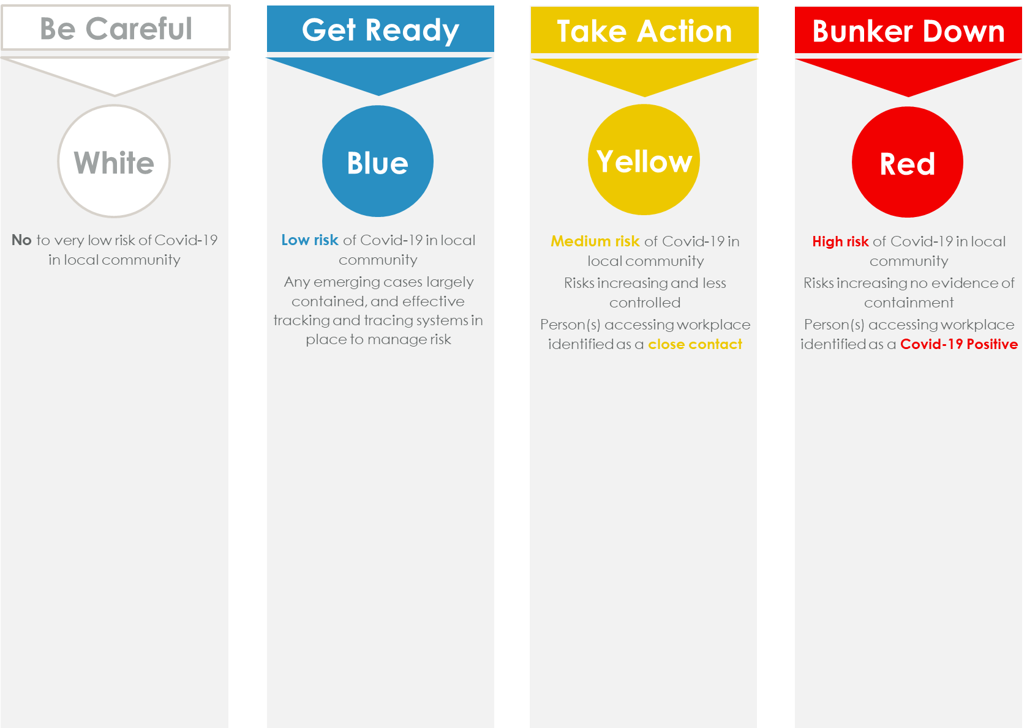
COVID-19 Risk Control Zones - Communication
Parkerville CYC’s localised COVID-19 Risk Control Zoning provide guidance to all teams relating to actions to mitigate risks:
EY SMEs
Audience
Staff Meetings/ Updates
All Workers
Bi-Monthly, 1st Tuesday of the month
Bi-Monthly, 1st Tuesday of the month
Additional as needed
Fortnightly via Teams on Tuesdays
Additional as needed
Fortnightly via Teams on Tuesdays
Additional as needed
Integrated Leadership Team Briefings
All PPL/M/PL/CL/TLs
Monthly, 1st Thursday of the month
Monthly, 1st Thursday of the month
Additional as needed
Fortnightly on Thursdays
Additional as needed
Fortnightly on Thursdays
Additional as needed
COVID Email Alerts/Video updates
All Workers
As needed following significant COVID-19 announcement
As needed following significant COVID-19 announcement
As needed following significant COVID-19 announcement
As needed following significant COVID-19 announcement
COVID Taskforce Meetings
Weekly, Wednesdays
Additional as needed
Daily 8.30am Huddle
Additional as needed
CTF
Every 3 weeks
Fortnightly, Wednesdays
Exec COVID Meetings
Exec Team
Following significant COVID-19 announcement to agree zone demarcation, actions and communication

Slide 10
COVID-19 Daily- Dashboard
Workforce Isolating
External Context → Emerging Issues:
Increasing numbers, though contract tracing is managing load
Low unemployment rates - employing people on casual contracts challenging
Changes from Fair Work need to be incorporated into thinking
Some PPE hard to get and on back orders
-
Internal Context →
Emerging Issues:
Learning: Casual Contacts who working in close spaces with clients (i.e., small counselling rooms in community settings)–WFH via telehealth until 2nd test result is in. Use N95 masks
Recruitment of Nurse for COVID Coordinator role in progress hopeful of making an appointment quickly
PPE on order – masks, aprons, RATS, and shared office equipment
-
Red Zone
Sites
1
Total
0
1
Critical Service
Roles
0
Service Support Roles
0
Yellow Zone
Sites
Workforce Off With COVID
0
Total
0
Critical Service Roles
0
Service Support Roles
0
Blue Zone
Sites
PPE Supply Levels
All Workers Key Actions / Responsibilities
-
N95/P2 Masks
Update WFH applications
Wellbeing plans completed
Practice PPE usage
Refer to, and read the resources on the Intranet
Keep your line manager informed
Face Shields
2
Gloves
Goggles
White Zone
Sites
Gowns
Rapid Antigen Test Kits
1
Hand Sanitser
Low
2 weeks
2 months +
As at 02/02/22
DESIRE
KNOWLEDGE
ABILITY
REINFORCEMENT

Slide 11
Key current focus areas: 02/02/22
Staff Wellbeing: People and Culture
Staffing - surge
Check increased EAP sessions still in place – share information with team
Personal Self Care Plan – use to work our specific needs for each team member
Finalise recruitment of COVID 19 Response Coordinator RN ASAP
Identify cost effective online supports additional to one already in place – Yoga, mindfulness
Share resources and approach with others – YACWA, WACOSS, CPAC, smaller organisations being supported by Parky.
Identify core and critical activities
Identity service model amendments to meet positive cases in 24/7 services
Check major change clauses to enable new staffing models to be implemented urgently
Identify houses/assets and team members that can support +ve cases
Identify budget issues that will create barriers to implementing service needs
Explore appetite for weekly shared business continuity meetings with DoC and other providers with an aim of backing and supporting each other

Slide 12
Thank you
We hope that in our transfer or learnings there is something that will make a difference or sparked an idea for you.
We have not done this work alone – Thank you to our very kind and generous friends both here in WA and over East (Anglicare Victoria and NSW in particular) for sharing your knowledge - we hope that we have also been of service to you in some small way.
Special mention and thank you must go to Anglicare WA for their permission to use and share widely their exceptional COVID 19 Response Plan Template – we ‘Parkified’ it and added bits, but we did it off the back of their incredible work and generosity.

