Slide 1



Louise Giolitto
WACOSS CEO
John Bouffler
CEWA Executive Director
6 Feb 2019
Sustainability & Advocacy Consultation

Slide 2
Introduction and Acknowledgement of Country
Debra Zanella, WACOSS President
I would like to acknowledge the Whadjuk people of the Noongar nation as the traditional owners and custodians of the land on which we meet.
We pay our respects to their elders, past present and future … and commit to walk with them on a journey of learning and reconciliation as we seek – as mission driven organisations – to deliver inclusive and culturally appropriate services that help close the gaps in life outcomes and empower Aboriginal people to meet their aspirations for healthy and resilient communities and a better life.

Slide 3
Objectives of today’s consultation
Provide background to research and advocacy work to date
Share our thoughts and suggested strategies
To hear from members as to what else can be done, and to develop a cohesive and collective advocacy approach

Slide 4
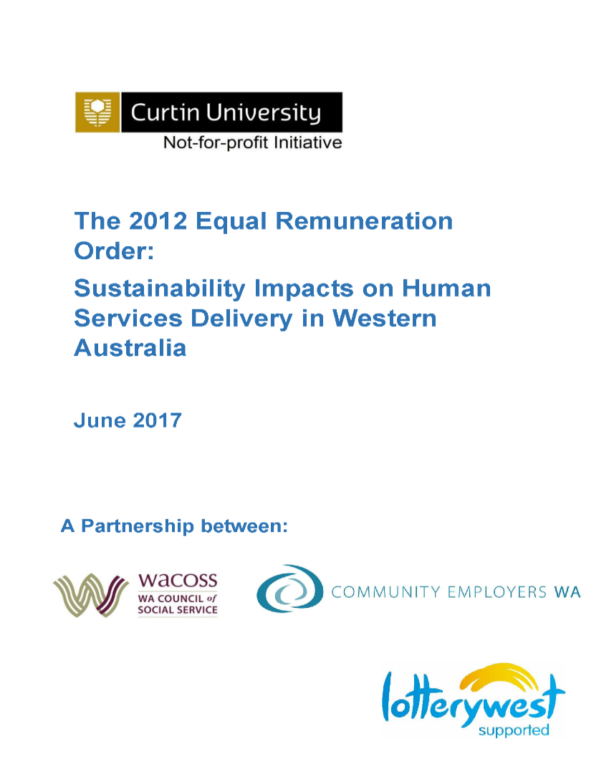
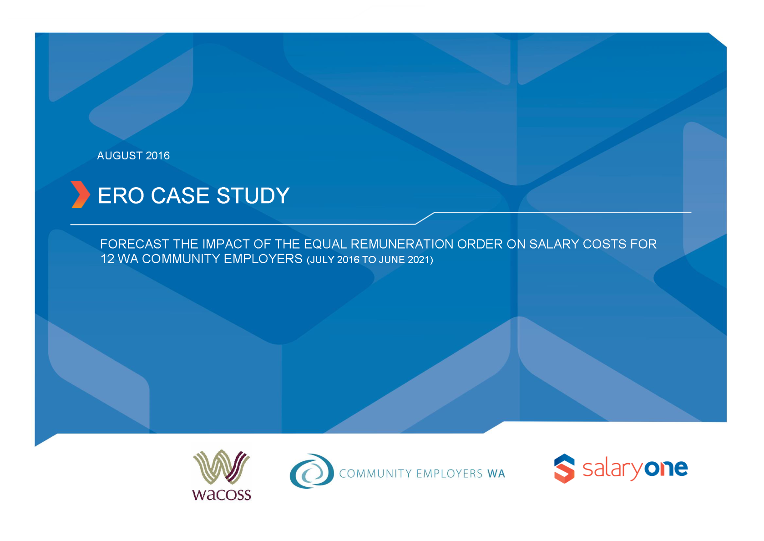
Background
What our members have been telling us
Previous Research commissioned by CEWA and WACOSS, Salary One 2016 Case Study and Curtin in 2017
Department of Communities Study in 2018

Slide 5
What we Know
 | Annual Wage Review | Gov Indexation | Indexation Gap | ERO Cumulative | Component 1
July 2010
July 2011 | 3.40% | 4.00% | -0.60% |  | 15.00%
July 2012 | 2.90% | 4.25% | -1.35%
Dec 2012 |  |  |  | 3.56%
July 2013 | 2.60% | 3.50% | -0.90%
Dec 2013 |  |  |  | 7.11%
July 2014 | 3.00% | 2.65% | 0.35%
Dec 2014 |  |  |  | 10.67%
July 2015 | 2.50% | 1.90% | 0.60%
Dec 2015 |  |  |  | 14.22%
July 2016 | 2.40% | 1.60% | 0.80%
Dec 2016 |  |  |  | 17.78%
July 2017 | 3.30% | 0.83% | 2.47%
Dec 2017 |  |  |  | 21.33%
July 2018 | 3.50% | 0.83% | 2.67%
Dec 2018 |  |  |  | 24.89%
July 2019 F'cast | 3.00% | 1.50% | 1.50%
Dec 2019 F'cast |  |  |  | 28.44%
July 2020 F'cast | 3.00% | 1.50% | 1.50%
Dec 2020 F'cast |  |  |  | 32.00%
July 2021 F'cast | 3.00% | 1.50% | 1.50%
 |  | TOTAL GAP | 8.54%
.

Slide 6
CEWA and WACOSS advocacy to date
.
We have collectively and separately met with a wide range of government people to highlight WACOSS and CEWA members’ concerns including
Through the Funding & Contracting working Group and the Partnership Forum
Prior to the March 2017 election with Labor Opposition members
Via letters to the Premier and Ministers following their election
In meetings with Grahame Searle, DPC, Treasury and various departments executives
Through recent individual member meetings with the Department of Finance

Slide 7


Slide 8
WACOSS State Budget Submission – Vision 2020
Ensure all new and existing contracts are DCSP compliant and services are resourced to deliver appropriate quality, coverage & outcomes.
Outcome: What does success look like?
The aspirations and commitments of the DCSP policy are delivered at a community level to ensure that services are outcome driven with appropriate service quality and coverage to meet community need. Community service jobs are fair and rewarding, giving workers the job certainty necessary to invest in knowledge and skill development and the confidence to care and provide meaningful support to those who need and want their assistance. Service providers who are effective and efficient service managers have sustained and predictable funding contracts that enable them to demonstrate impact, plan for the future, and focus on improving service quality and outcomes.

Slide 9
Responses From WA Government
.
Ministers, Treasury, Department of Finance, Department of Communities have told us
Organisations should have included ERO when tendering for any contract after 2012
They believe that Components I and II covered the majority of the ERO cost
Acknowledged that 24/7 homeless services MAY have an issue
Organisations can seek to re-negotiate contracts with the Government line agency. This does not mean an automatic increase in funding. Could result in variation in Outputs and Outcomes
The change to the NGHSS indexation policy was in line with the public sector wages policy

Slide 10
Delivering Community Services In Partnership Policy
Sustainable Service Delivery
Sustainable funding is a key factor of sustainable service delivery and enhances the capacity of Organisations to make long-term strategic decisions, attract and retain human capital, manage operational risk, achieve desired outcomes and deliver better value- for-money.
Sustainable service delivery refers to the ability of the Organisation to continue to provide services
over a long period. Public Authorities must purchase Community Services at a sustainable price.
Indexation
Contracting arrangements are to be indexed in accordance with government policy. The agreement
will be indexed at the rate of indexation formulated by the Department of Treasury and published by
the Department of Finance’s Government Procurement. Indexation does not apply to grants.
.

Slide 11
Delivering Community Services In Partnership Policy
Documents that Support DCSP
  Planning In Partnership Guide
  Procurement Practice Guide
  Probity and Accountability Policy
  Community Services Contract Management Guide
  Documents can be found on Department of Finance Website
https://www.finance.wa.gov.au/cms/Government_Procurement/Policies/Delivering_Community_Services_in_Partnership.aspx
.

Slide 12
Delivering Community Services In Partnership Policy
  Community Services Contract Management Guide
The aim of service agreement management is to promote sustainable procurement practice, ensure the desired community outcomes are achieved and reduce any unnecessary administrative burden placed on the service provider. It is also important to ensure all parties meet their obligations under the service agreement.
3.1.1 Variation Process
To avoid exposing Public Authorities to undue risk, service agreement managers should ensure that any proposed changes to a service agreement are managed in accordance with formal procedures as follows:
a written record is made of any potential need for the variation;
the full implications of change are considered including before making any amendments to the service agreement or the service agreement price;
those involved have the authority to negotiate changes;
each step of the action taken is recorded, with any changes incorporated in the service agreement by a formal variation to the original; and
stakeholders are informed of the changes.
.

Slide 13
What Can we Do
Example Letter –
    Why we need multiple organisations to take Action and advocate
    Key actions and message, SUSTAINABILITY of services for the Community
Dear [Contract Manager],
Re: Funding and Contracting - Sustainability of Services
We are writing to seek your support in reassessing the level of funding provided to [your organisation’s name] for the [name of program].
As you would be aware, this program has been in place for [number of years], and given the extensions which have occurred, there has not been an appropriate opportunity to reassess the adequacy of the funding in conjunction with the required service levels and outcomes……………………….
.

Slide 14
What Can we Do
Example Spreadsheet

Slide 16
CPI and ERO Increases

Slide 17
Estimated ERO and Award Increases to July 2020

Slide 18
What Can we Do
  How can we track the collective loss of Services to the Community?

Slide 19
What Can we Do
Next steps:
Members are encouraged to use the template letters to write to Contract managers, Ministers and local parliamentarians
Emphasise impact on Service Users, employees and the broader community
Focus on risk management and potential impact on quality of service
In EVERY meeting with politicians, highlight sustainability issues stemming from government policy
In every tender, ensure that pricing reflects the true cost of service delivery over the full term of the contract
Prepare longer term forecasts and discuss them with your boards –
they also have an advocacy role

Slide 20
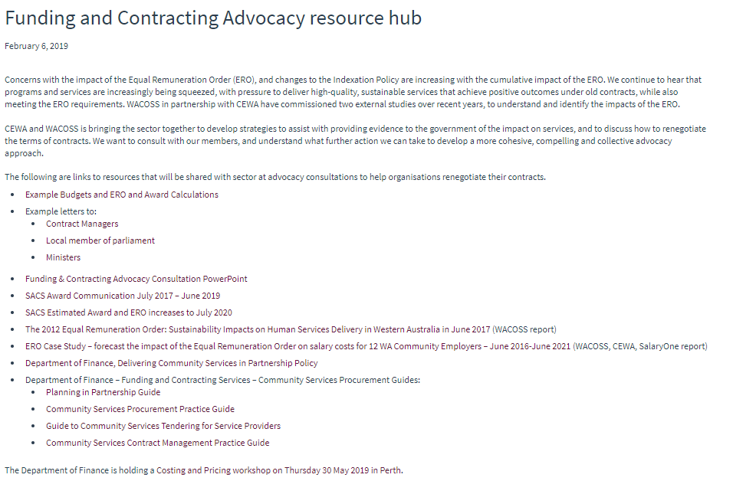
http://wacoss.org.au/news/funding-and-contracting-advocacy

Slide 21
Questions, Discussion and Action
Sustainability & Advocacy Consultation

